Slide 1
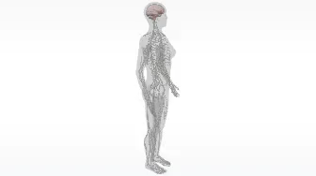
Neurons
AEPSY Year 11 ATAR Psychology

Slide 2
Review
What is the function of the CNS?
What is the function of the PNS?
Name the two sub-systems of the PNS
Give an example of an autonomic sympathetic effect.
Give an example of a somatic motor effect.

Slide 3
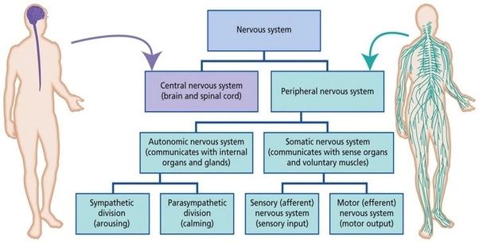

Slide 4
Learning Intentions
features of neurons
structure and function of the neuron – dendrites, soma/cell body, axon, axon terminals, myelin sheath
functions of sensory, motor and interneurons

Slide 5
Success Criteria
Label an anatomic diagram of a typical neuron.
State the function of the dendrites, soma, axon, axon terminals and myelin sheath.
Classify neurons as sensory, motor and interneuron, by diagram or description of function

Slide 6
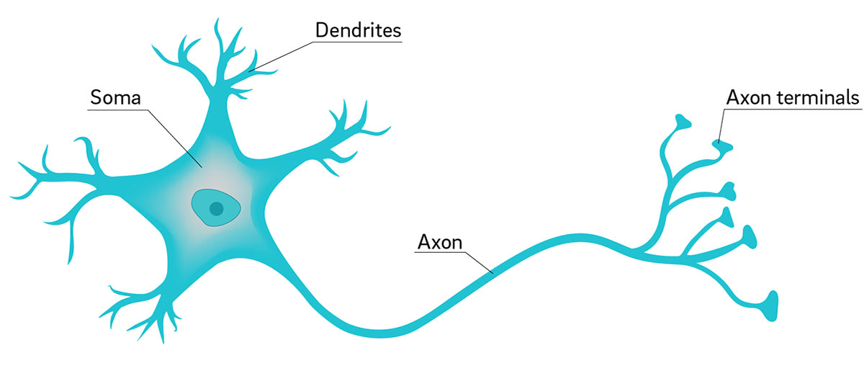
Parts of a neuron
Dendrites: fibres that receive and convey messages to cell body
Soma (cell body): metabolic centre of the cell (contains the nucleus)
Axon: fibres that conduct impulses away from the cell body
Axon terminal: branching fibres at the end of the axon, contain vesicles filled with neurotransmitters
Direction of impulse ------→

Slide 7
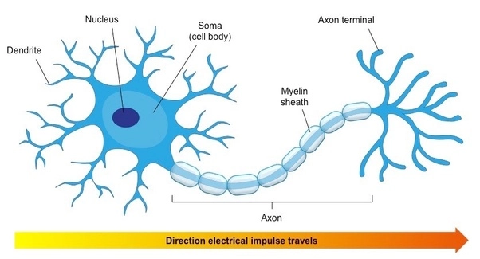
Myelin sheath
Some neurons have a covering of whitish, fatty material called myelin, which insulates the nerve fibre and increases the rate of transmission of the nerve impulse

Slide 8
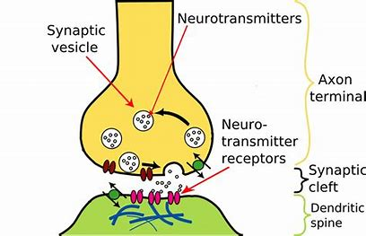
Axon terminal
Axons branch into hundreds or thousands of axon terminals, which contain vesicles (sacks) of neurotransmitters.
When a nerve impulse reaches the axon terminal, it stimulates the release of neurotransmitters

Slide 9
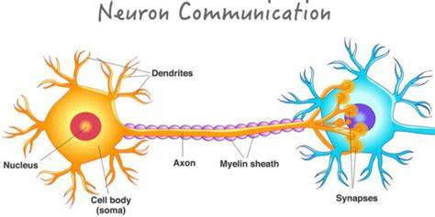

Slide 10
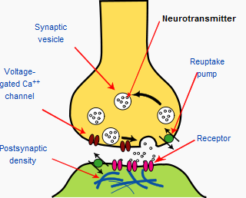
Synapse
Neurons don’t actually touch each other. The gap between them is called a synapse. Neurotransmitters diffuse across the synapse to continue cell to cell communication.

Slide 11
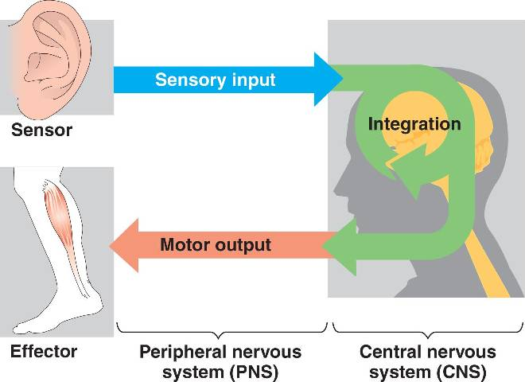
Primary Functions
Sensory (afferent) neurons
Interneurons
Motor (efferent) neurons

Slide 12
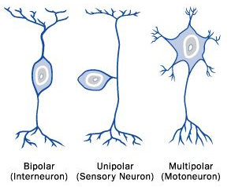
Classification of neurons

Slide 13
Success Criteria
Label an anatomic diagram of a typical neuron.
State the function of the dendrites, soma, axon, axon terminals and myelin sheath.
Classify neurons as sensory, motor and interneuron, by diagram or description of function

